Slide 1
Convergence property of different loss function and output activations
Speaker: Yu-Cheng Lin
Advisor: Prof. An-Yeu Wu
Date: 2019/12/12

Slide 2
Outline
Relation of WCE and f1-loss
Training procedure experiments and observations
Explanation on observations
Why f1-loss converges slow
More convergence property
Future work

Slide 3

WCE v.s. f1-loss
 | Pred 0 | Pred 1
True 0 | TP | FN
True 1 | FP | TN
WCE = CE*weight
Weight = 1/True
CE = TP
So,
WCE = TP/(TP+FN)
=precision
Recall=TP/(TP+FN)
Precision=TP/(TP+FP)
2/F1=1/Recall+1/Precision
* The only difference is that in pytorch CrossEntropyLoss
criterion, it pass through log-soft-max layer then nll-loss.
* However, log-soft-max will cause sum in dim 1 not equal to 1, which can’t represent probabilistic in intuition.
* So I choose soft-max layer in calculating f1-loss.

Slide 4
WCE loss
3 type
lr = 1e-3
0.81
WCE loss
4 type
lr = 1e-4
0.82
f1 loss
4 type
lr = 1e-4 , no dropout
0.84
0.80
0.84
f1 loss
3 type
lr = 1e-3, dropout 0.1
0.77
f1 loss
4 type
lr = 1e-4
3
0.79
WCE loss
4 type
lr = 1e-4
2
0.817
f1 loss
3 type
lr = 1e-3
1

Slide 5
WCE loss
3 type
lr = 1e-3
0.81
WCE loss
4 type
lr = 1e-4
0.82
f1 loss
4 type
lr = 1e-4 , no dropout
0.84
3
8
13
????
0.84
f1 loss
3 type
lr = 1e-3, dropout 0.1
0.77
f1 loss
4 type
lr = 1e-4
10,11
12
3
0.79
WCE loss
4 type
lr = 1e-4
6
2
0.817
f1 loss
3 type
lr = 1e-3
9
1

Slide 6
Explanation on observations
F1-loss converges really slow compared with WCE-loss
Directly training four types has poor performance, since deep feature of noisy signal is very different from others
F1-loss converges slow and noisy is hard to train thus causing poor performance
Good recall but poor precision makes f1 low

Slide 7
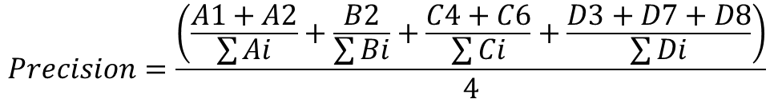
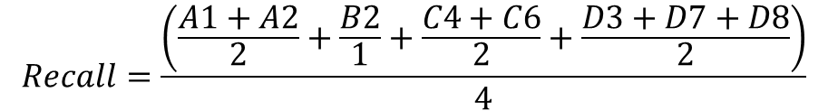
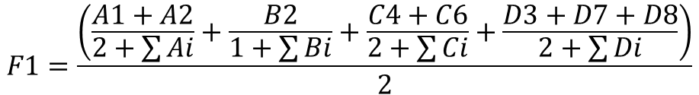
Why f1-loss converges slow (1/2)
Type
A1 | B1 | C1 | D1
A2 | B2 | C2 | D2
A3 | B3 | C3 | D3
A4 | B4 | C4 | D4
A5 | B5 | C5 | D5
A6 | B6 | C6 | D6
A7 | B7 | C7 | D7
A8 | B8 | C8 | D8
$$Recall=\frac{\left(\frac{A1+A2}{2}+\frac{B2}{1}+\frac{C4+C6}{2}+\frac{D3+D7+D8}{2}\right)}{4}$$
Data
index
$$Precision=\frac{\left(\frac{A1+A2}{\sum{Ai}}+\frac{B2}{\sum{Bi}}+\frac{C4+C6}{\sum{Ci}}+\frac{D3+D7+D8}{\sum{Di}}\right)}{4}$$
$$F1=\frac{\left(\frac{A1+A2}{2+\sum{Ai}}+\frac{B2}{1+\sum{Bi}}+\frac{C4+C6}{2+\sum{Ci}}+\frac{D3+D7+D8}{2+\sum{Di}}\right)}{2}$$

Slide 8
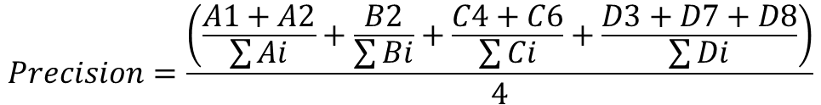
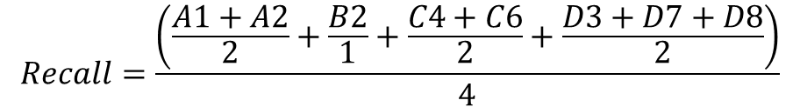


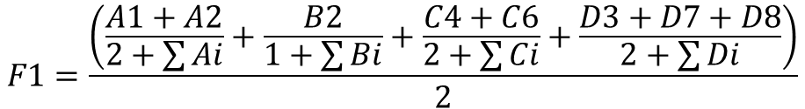
Why f1-loss converges slow (2/2)
$$Recall=\frac{\left(\frac{A1+A2}{2}+\frac{B2}{1}+\frac{C4+C6}{2}+\frac{D3+D7+D8}{2}\right)}{4}$$
$$\frac{∂Recall}{∂A1}=\frac{1}{8}$$
$$Precision=\frac{\left(\frac{A1+A2}{\sum{Ai}}+\frac{B2}{\sum{Bi}}+\frac{C4+C6}{\sum{Ci}}+\frac{D3+D7+D8}{\sum{Di}}\right)}{4}$$
$$\frac{∂Precision}{∂A1}=\frac{1}{4}\frac{(\sum{Ai})−A1}{{(\sum{Ai})}^{2}}$$
Gradient of A1 is inversely proportional to A1
$$F1=\frac{\left(\frac{A1+A2}{2+\sum{Ai}}+\frac{B2}{1+\sum{Bi}}+\frac{C4+C6}{2+\sum{Ci}}+\frac{D3+D7+D8}{2+\sum{Di}}\right)}{2}$$

Slide 9
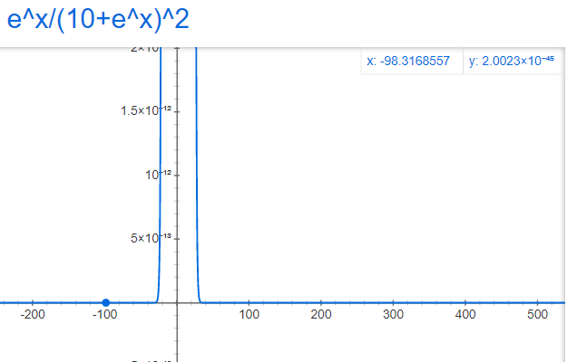
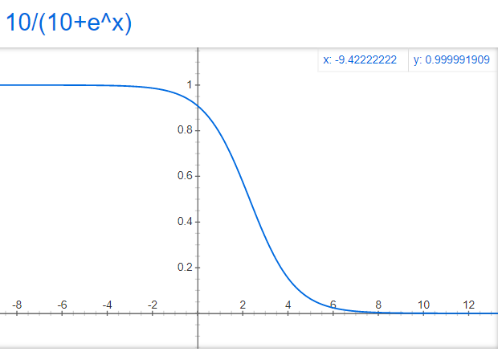

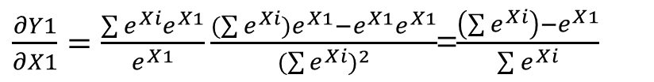
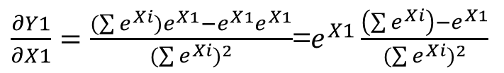

More convergence property
Log soft-max has better convergence property compared with soft-max
Softmax
Log-Softmax
X1
$$Y1=\frac{e^{X1}}{\sum{e^{Xi}}}$$
X1
$Y1=ln(\frac{e^{X1}}{\sum{e^{Xi}}}$)
X2
X2
X3
X3
X4
X4
$\frac{∂Y1}{∂X1}=\frac{(\sum{e^{Xi}})e^{X1}−e^{X1}e^{X1}}{{(\sum{e^{Xi}})}^{2}}$=$e^{X1}\frac{\left(\sum{e^{Xi}}\right)−e^{X1}}{{(\sum{e^{Xi}})}^{2}}$
$\frac{∂Y1}{∂X1}=\frac{{\sum{e^{Xi}}e}^{X1}}{e^{X1}}\frac{(\sum{e^{Xi}})e^{X1}−e^{X1}e^{X1}}{{(\sum{e^{Xi}})}^{2}}$=$\frac{\left(\sum{e^{Xi}}\right)−e^{X1}}{\sum{e^{Xi}}}$
Numerical unstable

Slide 10
Future work
Analyze the signal that cause wrong prediction in ~ type & O type

